Slide 1




Keep My Teeth
Welcome

Slide 2
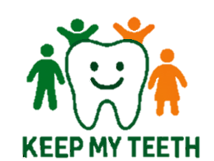
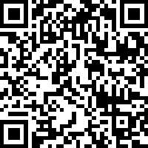
Welcome to Keep My Teeth
KMT Training will improve every day mouthcare in our workplace
Before we start
Write your name on your workbook. You can make notes here.
This training involves activities like brushing each other’s teeth – please let your trainer know if you want to skip steps or have any concerns.
Now, please complete your pre-training survey here

Slide 3

Welcome to Keep My Teeth
This training includes four modules that cover the importance of mouthcare, toothbrushing, mouthcare planning, and Putting it into Practice
Each module follows the same structure:
Prepare – Activity – Reflect

Slide 4
Why mouth care is important Keep My Teeth
Module 1

Slide 5
Prepare
In this module we are going to talk about:
1. Oral health basics
2. Mouthcare for people with disability
3. Barriers to mouthcare

Slide 6
Activity
Lets’ watch Video 1 - “Why mouth care is important”
We will pause, reflect and share as we go.
Play video on the next slide

Slide 7
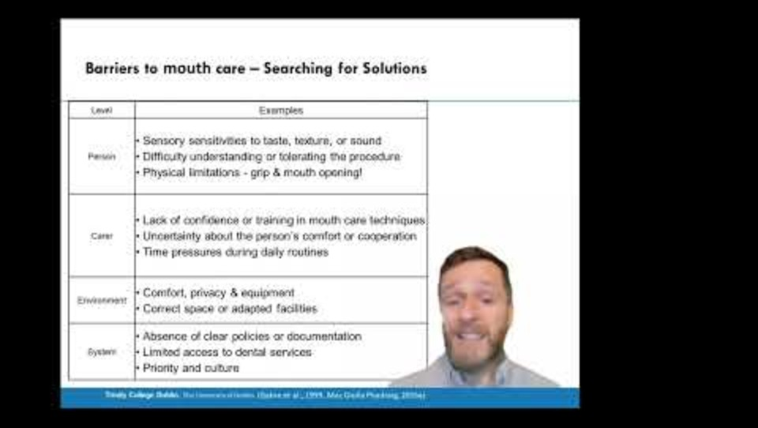

Slide 8
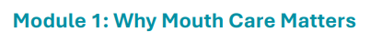
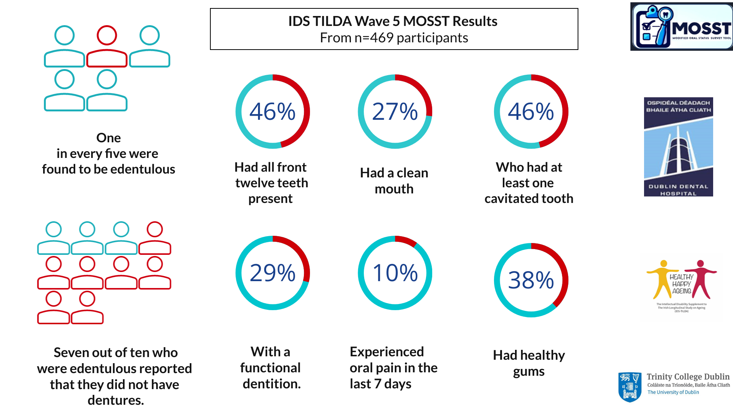
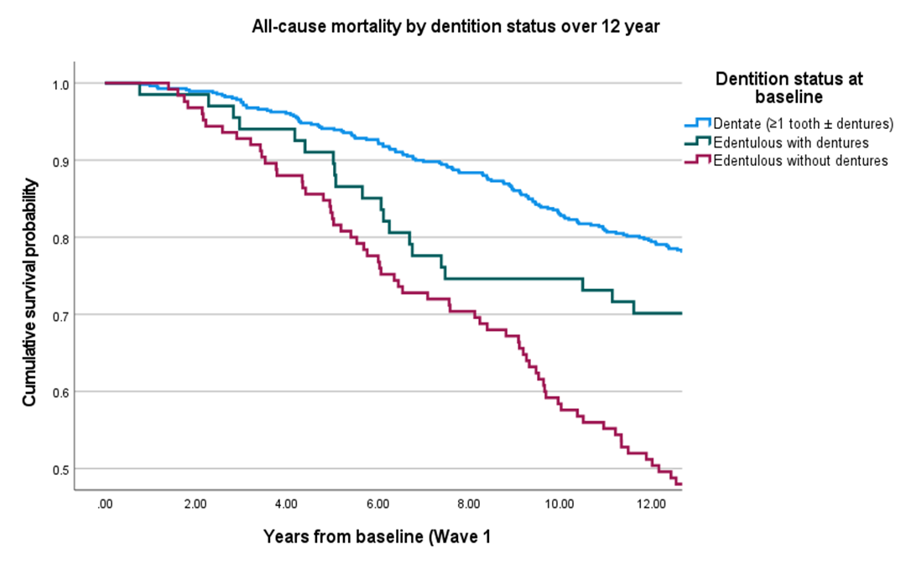
Increased risk when dentition reduced
4x Pneumonia , 3x Osteoporosis , 2x Constipation
Best survival: those retaining natural teeth; Intermediate: those edentulous with dentures; Worst survival: those edentulous without dentures – shortened survival by nearly 2 years.
Notes:
Best survival: those retaining natural teeth.
Intermediate: those edentulous with dentures.
Worst survival: those edentulous without dentures – shortened survival by nearly 2 years.
Risk of death is almost three times higher without dentures (unadjusted), and still 70% higher after adjustment for age, ID severity, residence and pneumonia history.
Similar pattern observed for respiratory mortality, aligning with known risks of aspiration, frailty and nutritional decline.
Simply replacing lost teeth with dentures eliminates most of this risk, bringing survival in line with dentate individuals.

Slide 9
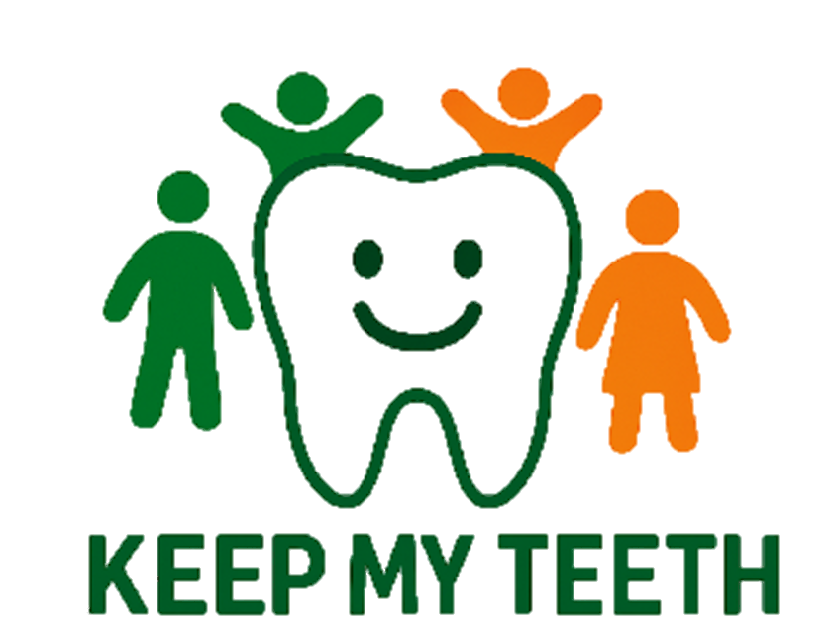
Reflect on Module 1
We covered why oral health matters, what mouthcare involves, and the barriers people face — plus solutions.
What can you change to improve mouthcare?
Now let’s move to the next module — Toothbrushing.

Slide 10
Toothbrushing Keep My Teeth
Module 2

Slide 11
Prepare
In this module we are going to:
1. Describe the 4 steps of Tooth brushing.
2. Learn how to brush teeth like a dentist.
We will brush each other’s teeth now. We know this can feel awkward. You can practice with your colleagues or just observe. This is a safe learning space.

Slide 12
Activity
Lets’ watch Video 2- Tooth Brushing
We will pause and practice as we go.
Play video on the next slide

Slide 13
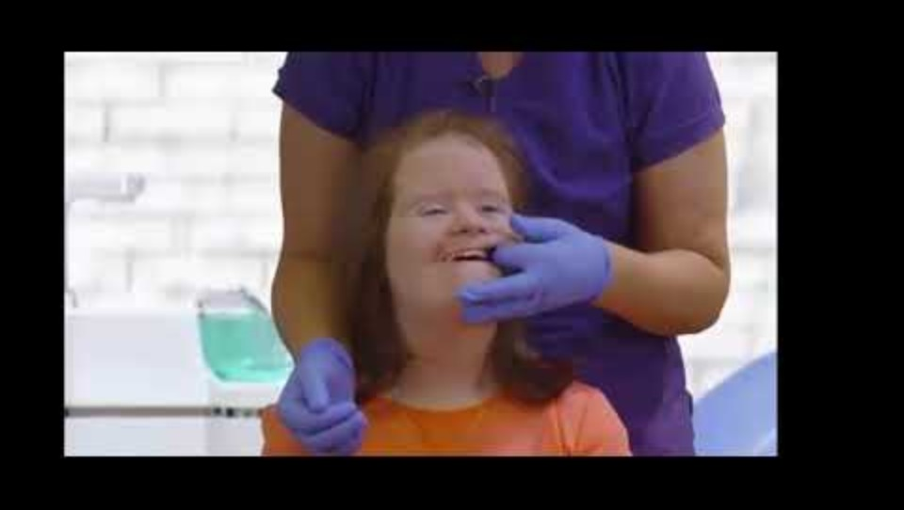
Activity

Slide 14
Reflect on Module 2
We covered why tooth brushing is important. We practiced the Four Steps of Tooth Brushing.
Ask - What can you change to improve tooth brushing?
Now let’s move to the next module — Mouthcare Plans
Notes:
What changes from today’s session we can make to offer a toothbrushing experience that is safer, calmer, and more effective for the people we support?

Slide 15
Building a mouthcare plan Keep My Teeth
Module 3

Slide 16
1. Prepare
In this module we are going to talk about:
1. The 4 steps of mouthcare planning.
2. How Mouthcare Plan reduces risks, improves predictability, and supports team consistency.
3. How a good mouthcare plan makes everyone’s job easier.

Slide 17
2. Activity
Lets’ watch Video 3 - “Building a mouthcare plan”
We will pause to discuss as we go.
Play video on the next slide

Slide 18
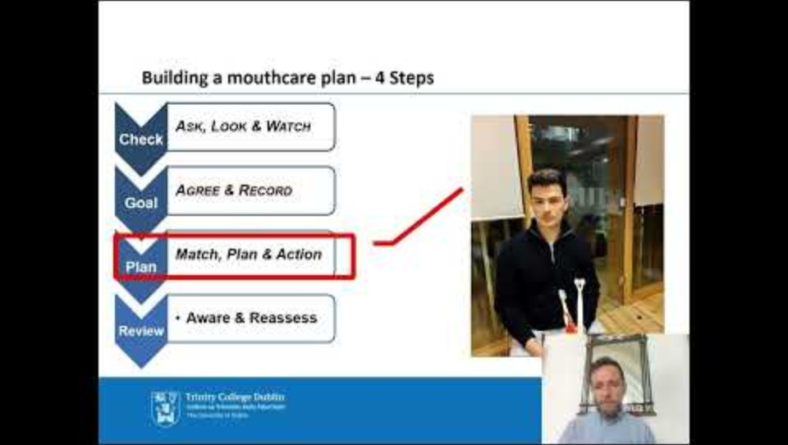

Slide 19
Reflect on Module 3
We covered why Mouthcare Plans are important. We practiced the Four Steps of MCPs.
Ask – How will you use MCPs to improve Mouthcare?
Now let’s move to the last module — Putting learning into Practice
Notes:
What changes from today’s session we can make to offer a toothbrushing experience that is safer, calmer, and more effective for the people we support?

Slide 20
Putting Learning into Practice Keep My Teeth
Module 4

Slide 21
1. Prepare
In this module we are going to talk about:
1. The Keep My Teeth vision
2. How you want to change in your team
3. How to deal with change
Notes:
What is takes to improve mouthcare in your organisation
Your role in supporting mouth care

Slide 22
2. Activity
Lets’ watch Video 4 - “Putting Learning into Practice”
Play video on the next slide

Slide 23
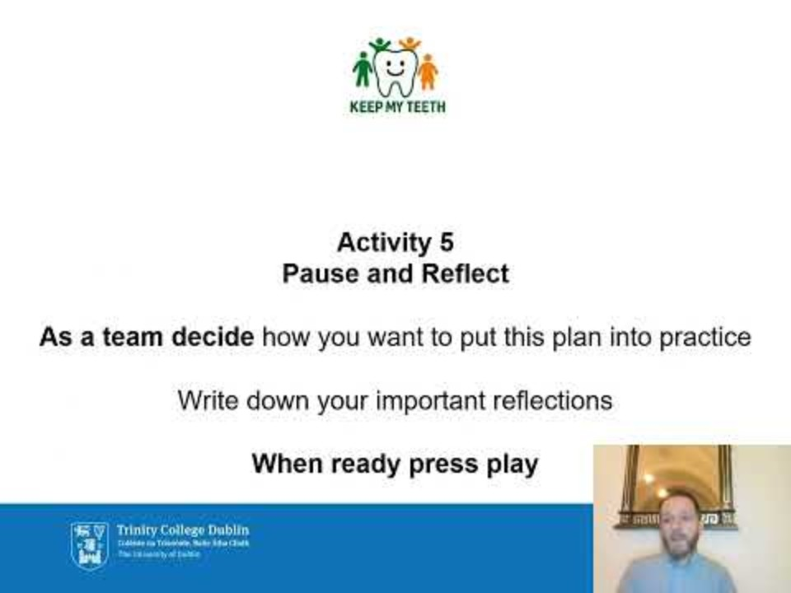
2. Activity

Slide 24
Reflect on Module 4
We covered practical steps for change. We explored team planning and supports.
Ask – What is your role in this change?
Now you’ve completed the last module – Time to wrap up
Notes:
What changes from today’s session we can make to offer a toothbrushing experience that is safer, calmer, and more effective for the people we support?

Slide 25
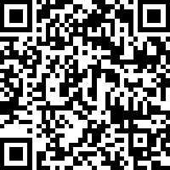
Course Completion - Wrap up
KMT Training will improve every day mouthcare in our workplace
As we finish
Make sure your name is recorded.
Take your workbook with you. It will be a useful guide.
Now, please complete your post-training survey here

